Slide 1
6.2 Exercises
Ori Rinaman
Bellevue University

Slide 2
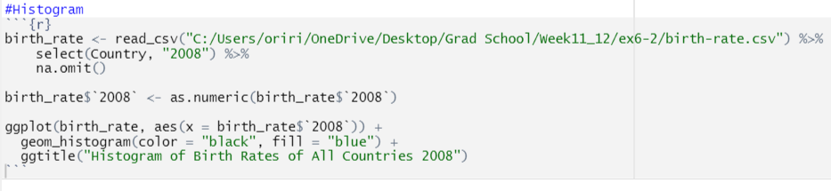
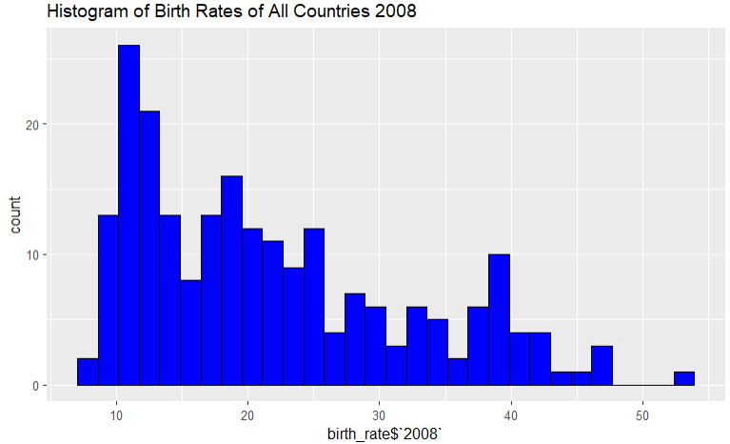
Histogram (R)

Slide 3

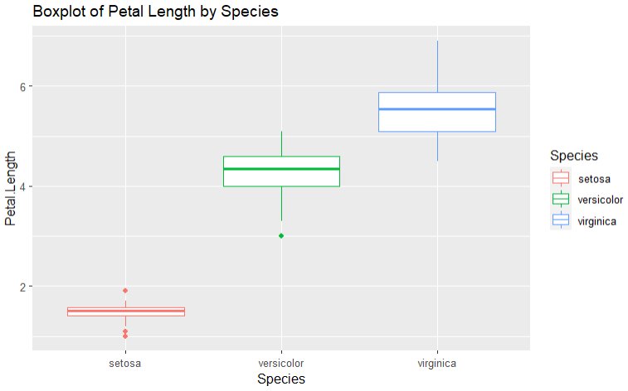
Boxplot (R)

Slide 4
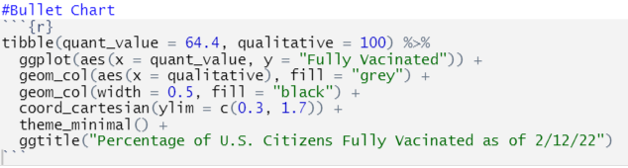
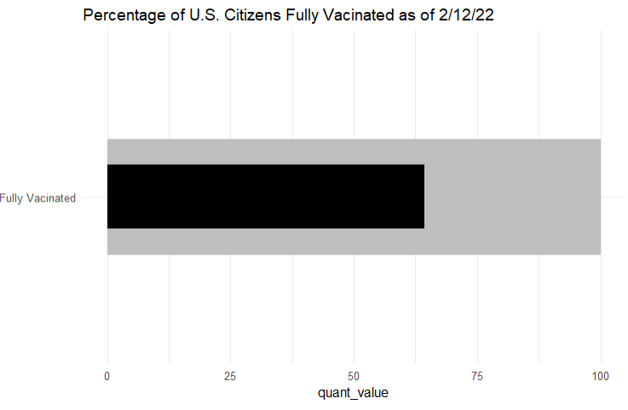
Bullet Chart (R)

Slide 5
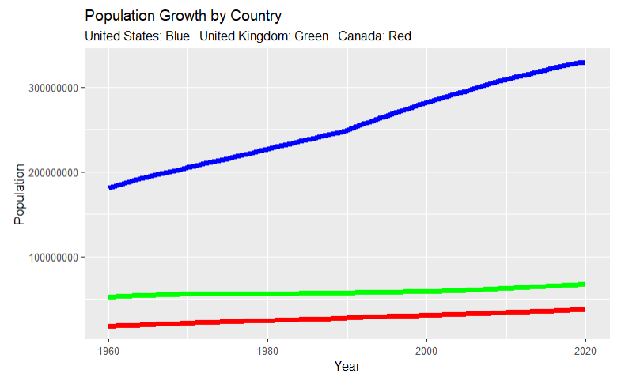
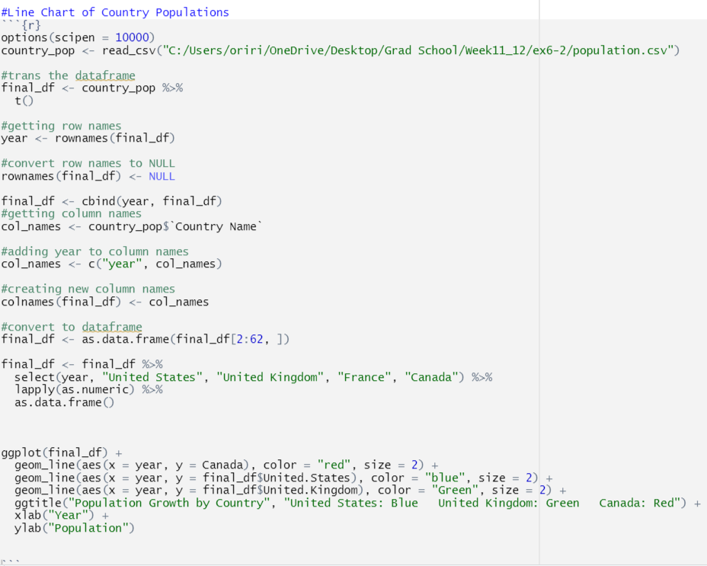
Additional Chart: Line Chart (R)

Slide 6
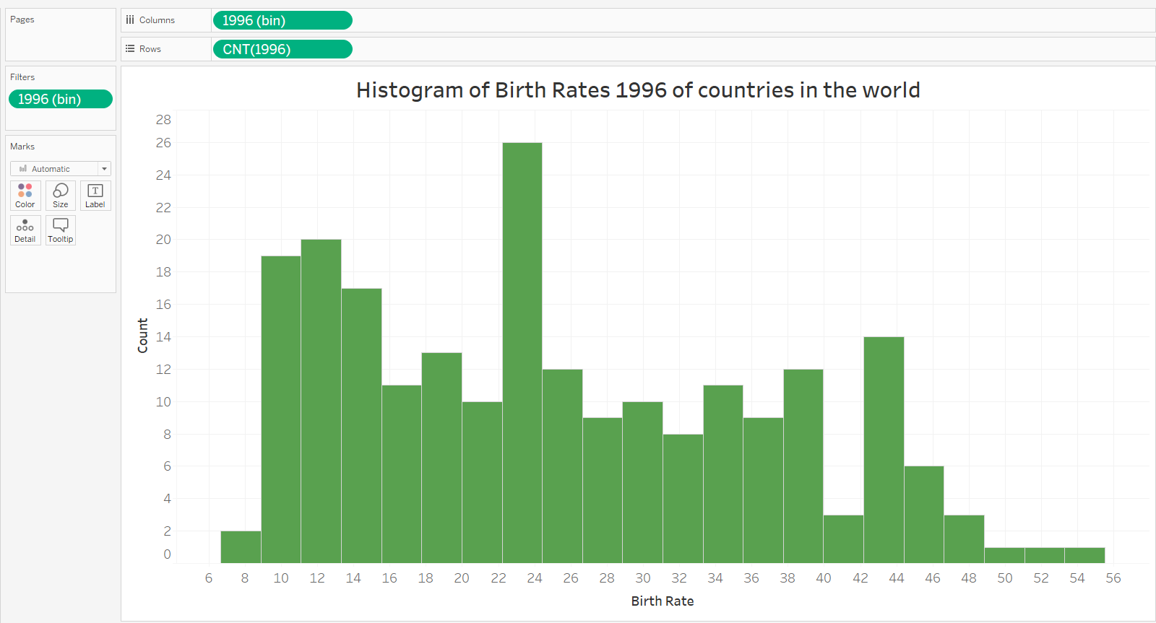
Histogram (Tableau)

Slide 7
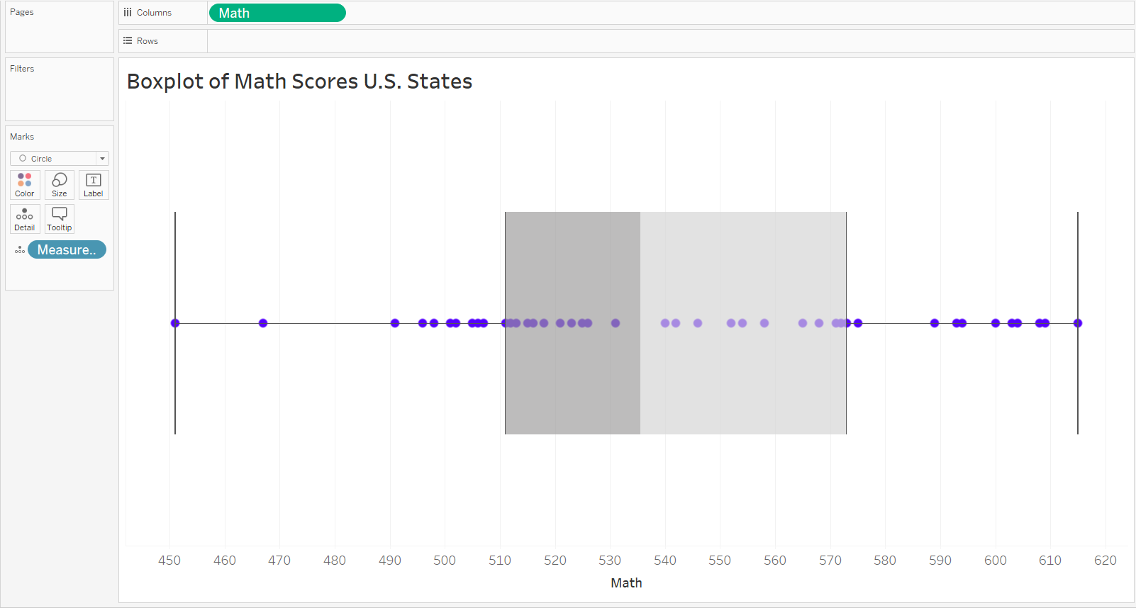
Boxplot (Tableau)

Slide 8
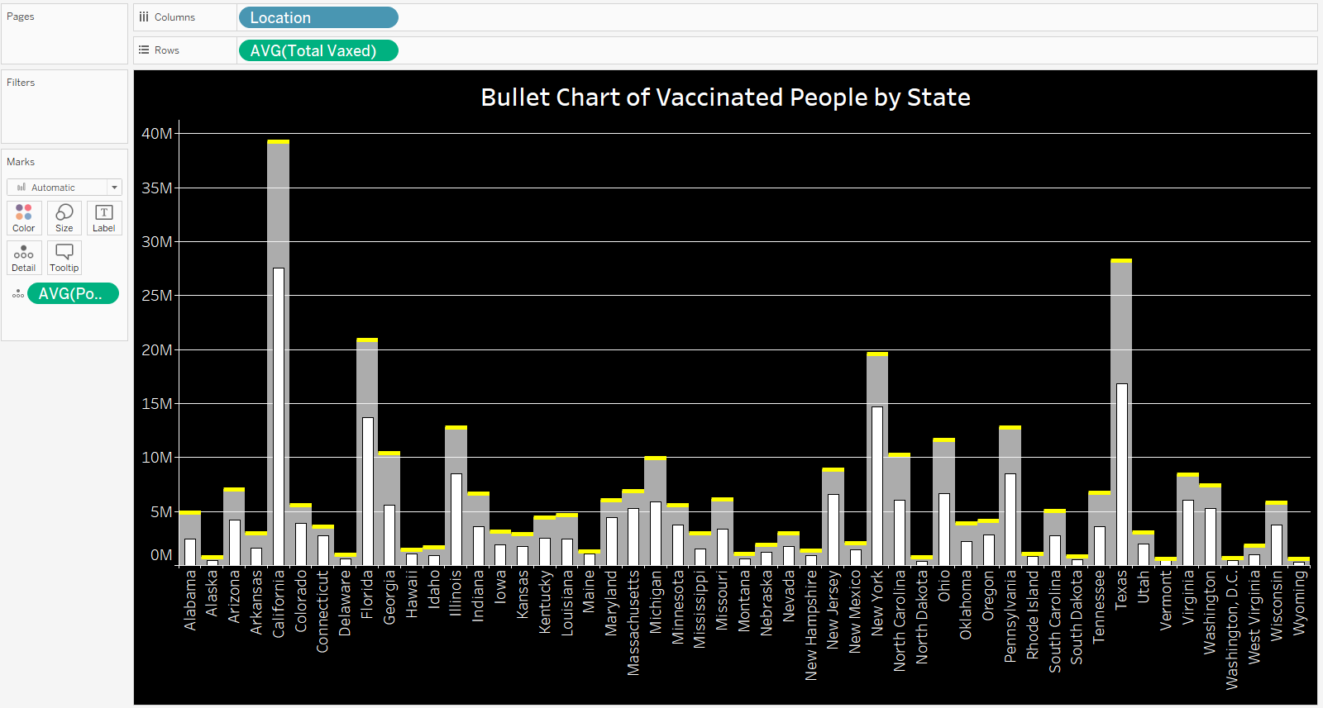
Bullet Chart (Tableau)
https://www.mayoclinic.org/coronavirus-covid-19/vaccine-tracker

Slide 9
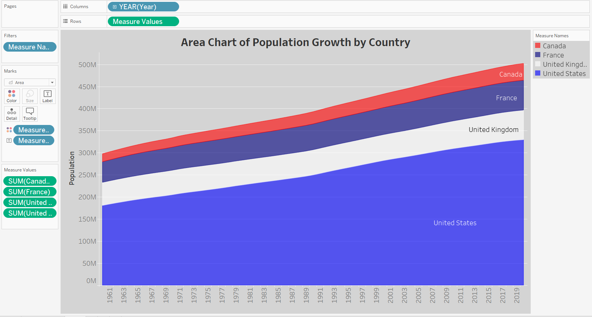
Additional Chart: Area Chart (Tableau)

Slide 10
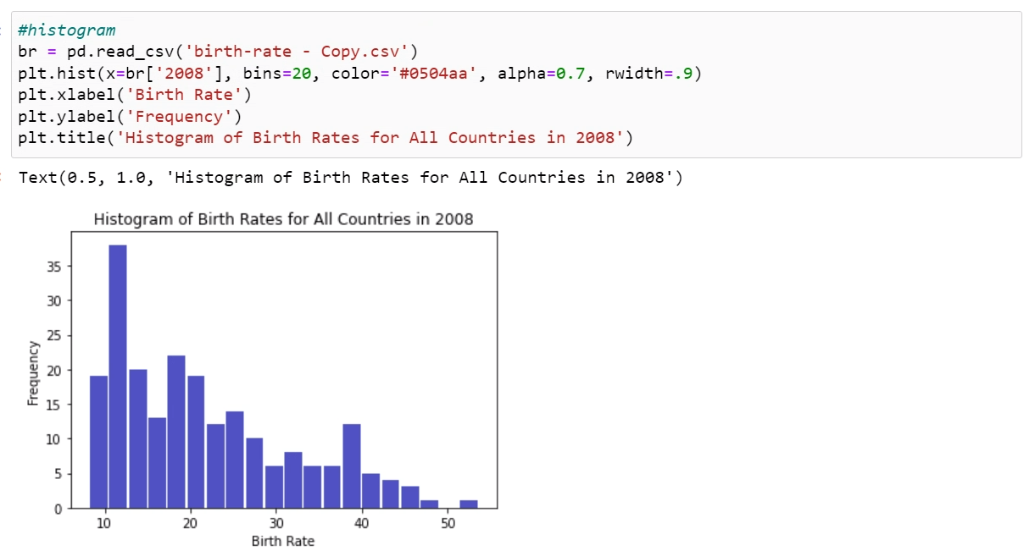
Histogram (Python)

Slide 11
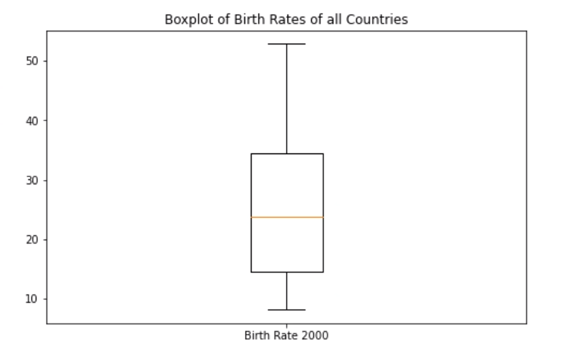
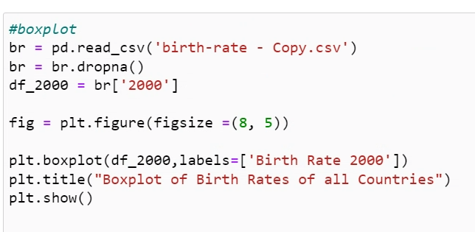
Boxplot (Python)

Slide 12
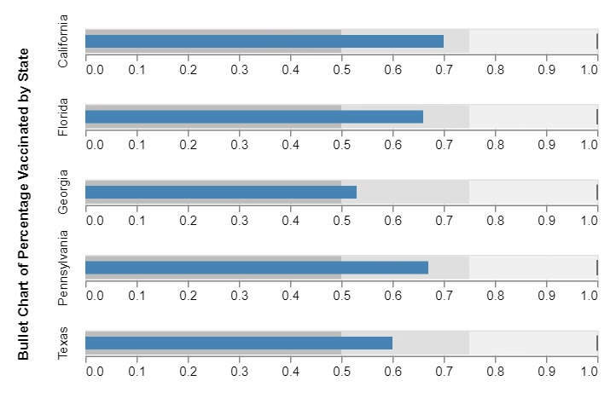
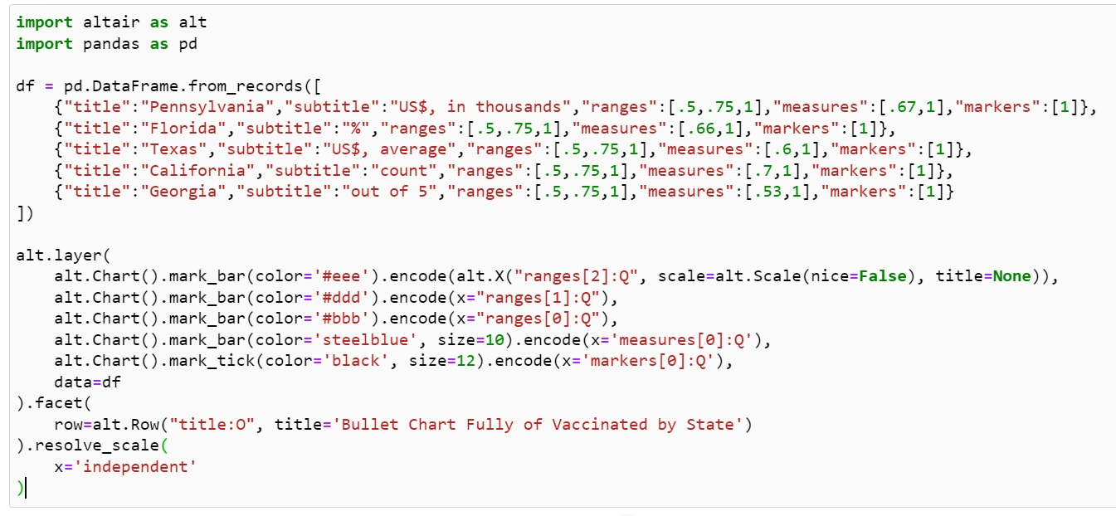
Bullet Chart (Python)

Slide 13
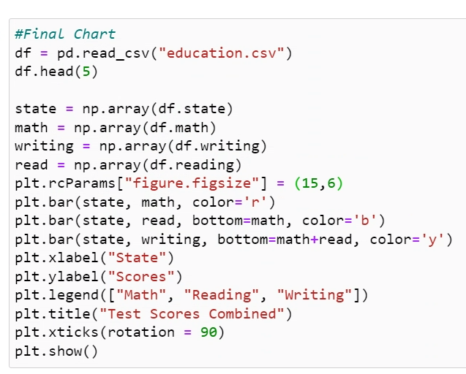
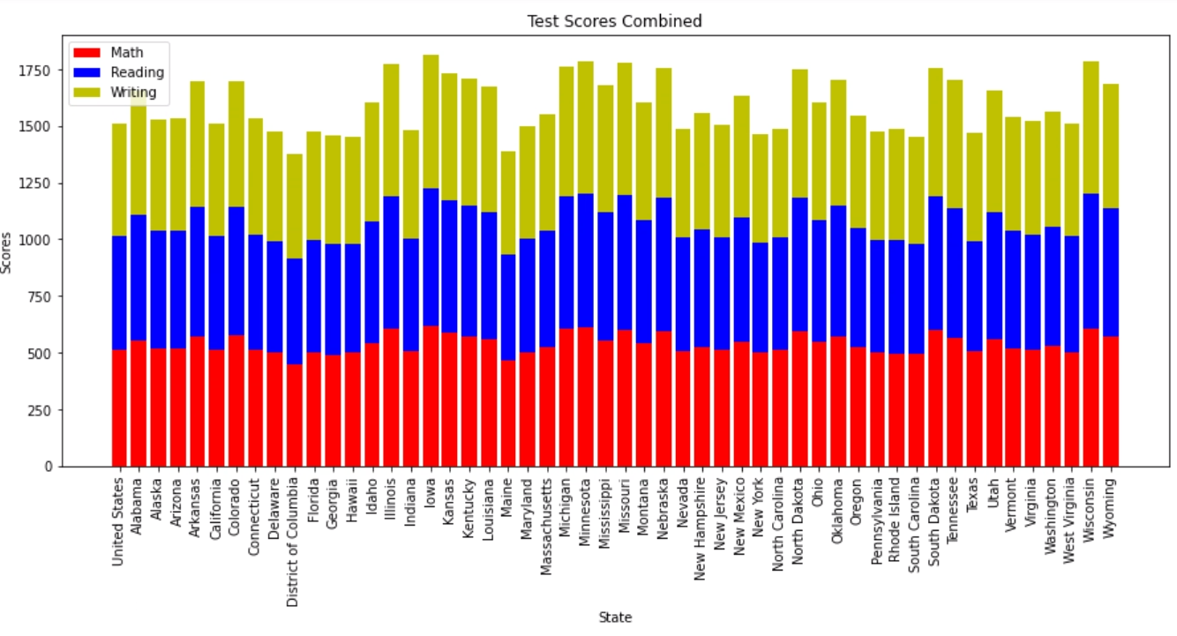
Additional Chart: Stacked Bar Chart (Python)

